Slide 1
SQL Business ANALYTICS
Marketplace Revenue
Leakage & Gap Analysis
using SQL
Actionable insights from 15 SQL-driven business tasks — margins, discounts, returns, logistics, and payment leakage.
SELECT root_cause
FROM marketplace_orders
WHERE profit < expected;

Slide 2
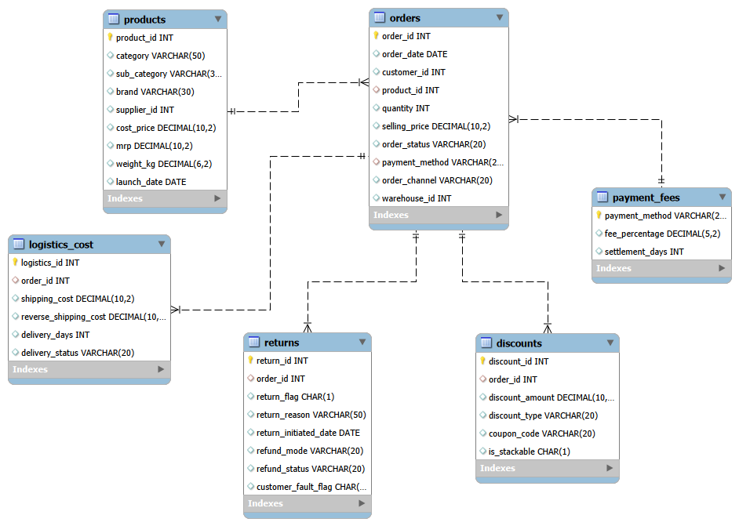

EER Diagram — marketplace_schema
SIX CORE TABLES
products
Catalog: category, brand, cost, MRP, supplier
orders
Order header: customer, price, status, channel
discounts
Discount amount, type & coupon linked to order
returns
Return flag, reason, refund mode & status
logistics_cost
Shipping, reverse-shipping cost & delivery days
payment_fees
Fee % and settlement days per payment method
1

Slide 3
Agenda
15 SQL analysis tasks, each paired with a clear recommended action.
1
Revenue vs Profit Reality
9
Logistics Cost Burden
2
Category-wise Sales & Profit
10
Payment Fee Leakage
3
Loss-Making Products
11
Revenue Leakage Breakdown
4
Discount Usage Overview
12
Product Profit Ranking
5
Payment Method Popularity
13
Category Margin Stability
6
Discount vs Profit Gap
14
High-Risk Customers
7
Return Impact on Revenue
15
Executive Profitability Summary
8
Return Reason Analysis
SELECT task, action
FROM agenda
ORDER BY task_no;
SQL Business Analytics | Tasks
2

Slide 4
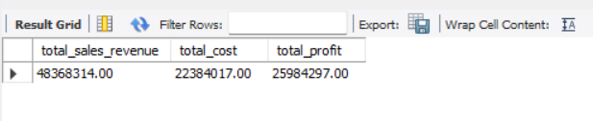
TASK 1
Revenue vs Profit Reality
RECOMMENDED ACTION
Use 53.7% gross margin as the benchmark for tracking profit health
Closely monitor discounts, returns, logistics, and payment fees
Track the gap between gross margin and actual net profit
Identify where money is being lost and take corrective action
SQL Business Analytics | PROFITABILITY RECOMMENDATIONS
3

Slide 5
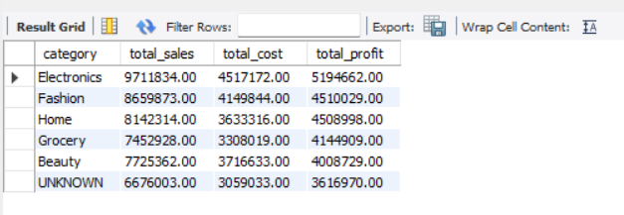
TASK 2
Category-wise Sales & Profit
RECOMMENDED ACTION
Electronics sells the most, but its profit margin is just average (53.5%)
so we should keep investing in it mainly for its sales volume, not because it's the most efficient category.
Home is our best all-round category
it has strong sales and a high margin (55.4%), making it worth backing on both fronts.
Beauty needs attention
it has the lowest margin (51.9%) of all categories, so there's real room to fix pricing or costs here.
"UNKNOWN" needs a different fix
its margin is actually healthy (54.2%), it just looks weak because products aren't tagged to a real category. This is a data-labelling fix, not a pricing problem.
SQL Business Analytics | Category Recommendations
4

Slide 6
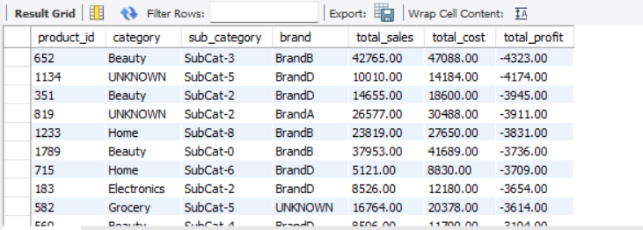
TASK 3
Loss-Making Products
RECOMMENDED ACTION
Start with the worst 10 products.
They alone cause almost half of the total loss (45.4%, ₹53,417). Fixing just these gives us the biggest improvement for the least effort.
Look closely at the Fashion category.
It has the most loss-making products, so review their pricing and supplier costs to identify the main causes.
For every loss-making product, do one of three things
Raise the price, negotiate a better deal with the supplier, or stop selling it if nothing works.
This isn't a big problem today (under 0.5% of total profit), but it can grow if ignored. So, we'll check this list every 3 months to catch new problem products early.
SQL Business Analytics | Loss-Making Recommendations
5

Slide 7
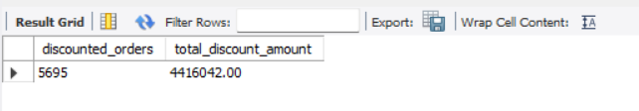
TASK 4
Discount Usage Overview
RECOMMENDED ACTION
Don't judge discount cost by its share of revenue (9%),
judge it by its share of profit (17%). it reframes the conversation from "manageable" to "material." and shows the problem is bigger than it first appears.
Check if the ₹775 average discount is spread evenly or driven by a few large discounts (worth a quick distribution check) This tells us if we need a discount approval limit.
Track “discount as % of gross profit” every month. This shows how much of our gross profit is being given up through discounts.
SQL Business Analytics | Discount Recommendations
6

Slide 8
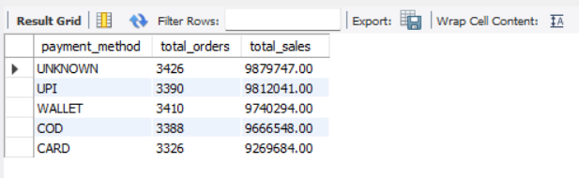
TASK 5
Payment Method Popularity
RECOMMENDED ACTION
Fix payment method captures at checkout
"UNKNOWN" being the top bucket which means we're making business decisions without complete information. So, Reduce UNKNOWN payment-method records and improve payment-method data capture.”
Layer in payment fee data next
before deciding which method to promote order volume alone doesn't tell you which channel is profitable, only which is popular.
Since order distribution is near-equal, There's no urgent need to "push" one method over another for volume but, once we look at cost (processing fees), some methods clearly save us more money than others so there's a good reason to encourage the cheaper ones, just not for volume, but to save on fees
SQL Business Analytics | Payment Recommendations
7

Slide 9
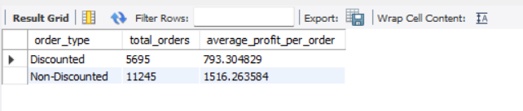
TASK 6
Discount vs Profit Gap
RECOMMENDED ACTION
Treat discounting as a profit trade-off, not a "free" growth lever.
With 34% of orders discounted and each one earning 48% less profit, this is a material, ongoing drag on total profit not a rounding error.
Find out which discounts are the real problem.
check if certain discount types (coupon vs. automatic) or categories (e.g., Fashion/Beauty, flagged earlier) are driving this gap disproportionately, so we can fix the actual cause instead of cutting discounts everywhere.
Test controlled discount reduction.
On a segment of orders to see if volume holds stays the same, this is pure margin recovery; if volume drops a lot, we'll finally know discounts are needed to keep customers buying, instead of just assuming it
SQL Business Analytics | Discount vs Profit Recommendations
8

Slide 10
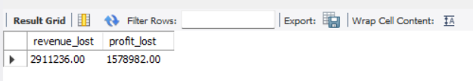
TASK 7
Return Impact on Revenue
RECOMMENDED ACTION
Find out why customers are returning items.
Is it bad quality, the wrong item being sent, damage during delivery, or customers just changing their mind? Each reason needs its own fix.
Fixing returns is different from fixing discounts.
For discounts, we reduce the amount we give away per order. But for returns, the real fix is reducing how many orders come back in the first-place fewer returns directly mean less revenue and profit lost, directly.
Set an internal target to bring returns down.
Reduce return-related revenue loss from the current 6% of revenue by setting an internal reduction target and tracking it as a recurring KPI. This requires ongoing monitoring because return rates can increase again without continuous attention.
SQL Business Analytics | Return on Revenue Recommendations
9

Slide 11
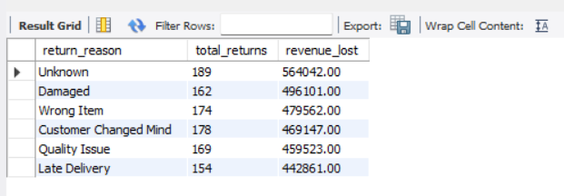
TASK 8
Return Reason Analysis
RECOMMENDED ACTION
Fix return-reason capture at the source.
"Unknown" being #1 means the biggest slice of loss is currently unexplained and unfixable until this is closed.
Prioritize the operationally fixable reasons first.
Damaged, Wrong Item, Quality Issue, Late Delivery for 65% of revenue lost to returns. We can act on these directly pack products better, double-check orders before shipping, improve quality checks, and hold couriers to better delivery timelines.
Track return reason as a monthly trend, not just a total.
spotting whether Damaged or Late Delivery is rising will show early warning of a process breaking down.
SQL Business Analytics | Return Recommendations
10

Slide 12
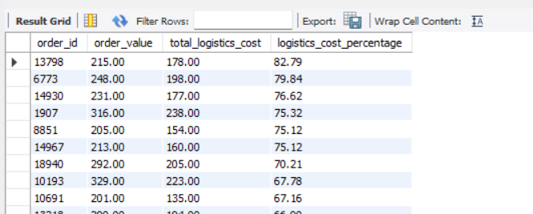
TASK 9
Logistics Cost Burden
RECOMMENDED ACTION
Many orders are spending a high percentage of their value on logistics. Some orders are spending 65–83% of their order value on logistics costs.
So, set a suitable minimum order value or delivery charge for low-value orders and review specific orders with very high logistics costs to understand what's driving them. This will help reduce logistics leakage and directly improve profit.
SQL Business Analytics | Logistics Recommendations
11

Slide 13
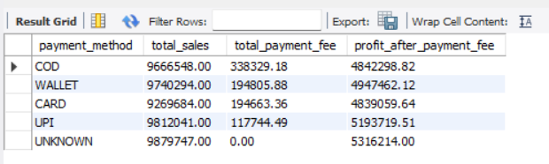
TASK 10
Payment Fee Leakage
RECOMMENDED ACTION
Promote COD costs the business the most in payment fees (3.5% of every sale), while UPI costs the least (1.2%) nearly 3 times cheaper.
So, we need to encouraging customers to pay via UPI or other low-fee methods
(Wallet, Card) instead of COD. Out of the total ₹8,45,543 spent on payment fees across the business, COD alone accounts for ₹3,38,329
The single biggest chunk. Shifting customers toward cheaper payment methods will directly save money and boost profit.
SQL Business Analytics | Payment Recommendations
12

Slide 14
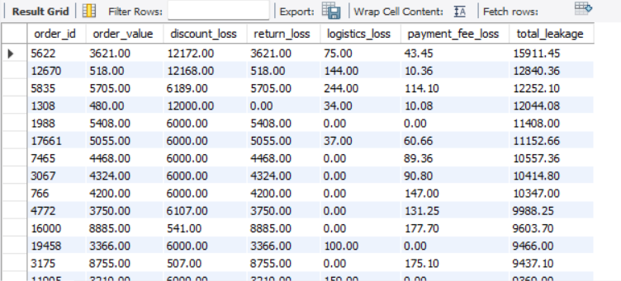
TASK 11
Revenue Leakage Breakdown
RECOMMENDED ACTION
Focus first on reducing returns, as they are the biggest leakage driver among the highest-loss orders return loss is the top factor in 71% of the 100 worst-leakage orders.
Across the business overall, discounts remain the single largest leakage source
(49.2% of all leakage, ₹44.16L), with returns close behind (31.7%, ₹28.44L). Together, these two factors account for 81% of total leakage.
So, first do prioritize in these two areas since it does the most damage in the worst-hit orders while also keeping discount depth and logistics costs under control, to protect overall profitability.
SQL Business Analytics | Revenue Recommendations
13

Slide 15
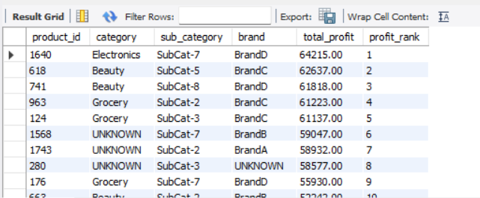
TASK 12
Product Profit Ranking
RECOMMENDED ACTION
It shows a clear gap in product profitability. The top 10% of products (138 SKUs) contribute ₹57.68L about 22% of total product profit while 46 products are actually losing money, total ₹1.18L.
So, focus on inventory and marketing on the best-performing products especially the top Beauty and Grocery items, while reviewing the loss-making ones.
particularly in Fashion, which has the most loss-makers despite also having several top performers for pricing, cost, or supplier fixes. Doing both should improve product-level profitability.
SQL Business Analytics | Product profit Recommendations
14

Slide 16
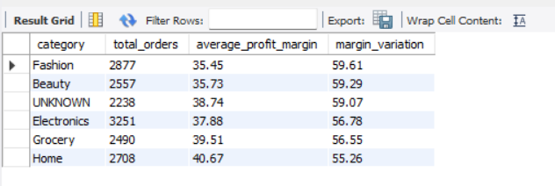
TASK 13
Category Margin Stability
RECOMMENDED ACTION
It Fashion and Beauty have the highest variation in profit margins 59.61 and 59.29 respectively These are the two least consistent categories, with the largest swings in profitability from order to order.
Fashion is also the weakest performer, with the lowest average margin (35.45%) combined with the highest variation the worst combination of unpredictable and thin.
So, we need to review pricing and product costs in both categories to improve margin consistency, using Home the most stable category, 55.26 variation, 40.67% average margin as the internal benchmark for what disciplined pricing looks like.
SQL Business Analytics | Category Margin Recommendations
15

Slide 17
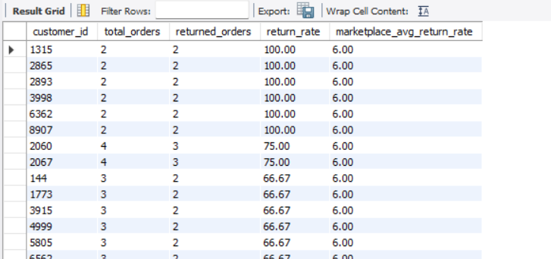
TASK 14
High-Risk Customers
RECOMMENDED ACTION
From the analysis there are 786 customers have a return rate more than twice the marketplace average and have placed at least 2 orders. This is a significant number, so high return behaviour needs closer investigation.
Do not treat all 786 customers as problem customers immediately. A high return rate can still be influenced by a customer's order volume, so customers with more orders and repeated returns should receive higher priority.
Focus first on customers with multiple returns and higher order volumes. This will help identify customers showing a consistent return pattern.
Analyse the return reasons for these 786 customers to determine whether the returns are caused by customer behaviour or operational issues such as damaged products, wrong items, quality problems, or late delivery.
SQL Business Analytics | High - Risk Recommendations
16

Slide 18
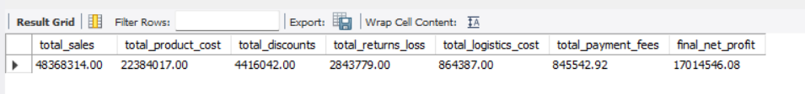
TASK 15
Executive Profitability Summary
RECOMMENDED ACTION
Our sales are strong (₹4.84 Cr), but discounts, returns, logistics costs, and payment fees together are ₹89.70L — pulling our margin down from 53.7% (gross) to just 35.2% (net).
So, first prioritizing action in order of impact:
discounts first (49.2% of total leakage, ₹44.16L).
Then Logistics (9.6%, ₹8.64L) and Payment Fees (9.4%, ₹8.46L) as secondary but still worthwhile areas to control.
Addressing these leakage points especially the top two is the clearest path to improving overall profitability.
SQL Business Analytics | Executive Profitability Recommendations
17

Slide 19
Key Takeaways
Sales are strong at ₹4.84 Cr, but discounts, returns, logistics costs, and payment fees together ₹89.70L in leakage pulling margin from a 53.7% gross margin down to 35.2% net margin. Discounts (49.2%) and returns (31.7%) together drive 81% of all leakage fixing these two first should be fixed, while keeping logistics (9.6%) and payment fees (9.4%) in checking is the clearest path to stronger, more predictable profitability.
₹4.84 Cr
₹89.70L
53.7% → 35.2%
49.2% + 31.7%
TOTAL SALES
TOTAL LEAKAGE
GROSS → NET MARGIN
DISCOUNTS + RETURNS SHARE
Thank You

